Slide 1
Digital Transformation in Tourism: Information and Analytical System for Creating Virtual Tours
Anna Bakurova, Vitalii Bilyi, Anastasiia Didenko and Elina Tereschenko
National University Zaporizhzhia Polytechnic
Khortytsk National Academy
2025

Slide 2
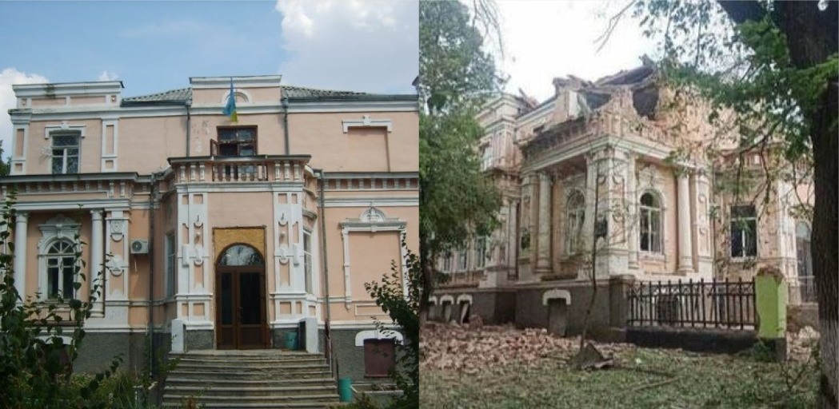
The main goal of the work is to improve the previously developed damage recording system by adding a new module that allows the creation of virtual tours of destroyed cities in southern Ukraine based on preserved photo and video material before and after the war
2

Slide 3
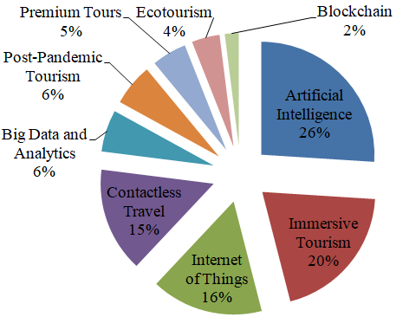
The impact of new trends and innovations on tourism
3

Slide 4
The presented tools can be classified into the following areas:
1. Tourist services:
a. AI for a tourism enterprise allows you to create customer profiles and plan the company's activities; for tourists, a virtual concierge is used during check-in and other interactions at the hotel, and chatbots are used when communicating about finding information about tours and tourist locations and solving problems;
b. This same direction includes the use of virtual, augmented and mixed reality when inspecting hotel rooms, etc.;
c. Big data analytics is used to collect and analyze data, improve the efficiency of business process management in the enterprise, and develop an offer and communication strategy according to customer profiles.;
d. Blockchain technology is a new way of payment that helps protect data and transactions;
e. IoT: these technologies allow for contactless hotel check-in and payment, voice control capabilities in the hotel room, and indoor comfort control;
2. Tour creation (alone or with a tour operator): using chatbots to search or create a tour, and tourism entities also use technologies to create tours (excursions) in augmented reality or completely virtual tours (excursions) to museums, etc.;
3. Virtual tours: using virtual, augmented and mixed reality to create virtual tours and excursions; using chatbots to search for information about tourist locations.
4

Slide 5
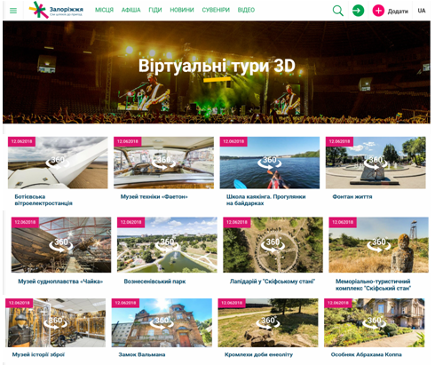
5

Slide 6
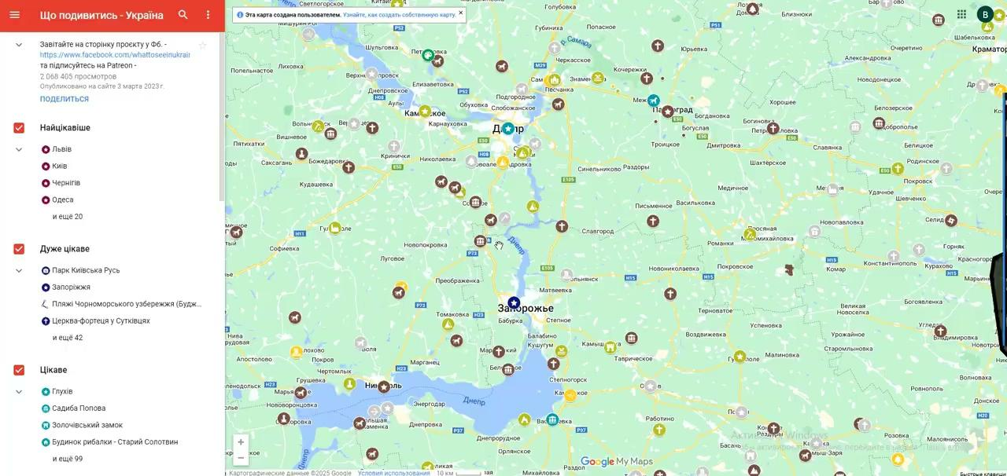
6

Slide 7
Tool | Free of charge | Level of customization | Ease of use
Krpano | no | high | medium
3DVista | no | medium | high
Matterport | partly | low | high
Kuula | partly | medium | high
Marzipano | yes | very high | low
Roundme | partly | low | very high
Panotour | no | medium | high
SeekBeak | no | medium | high
7

Slide 8
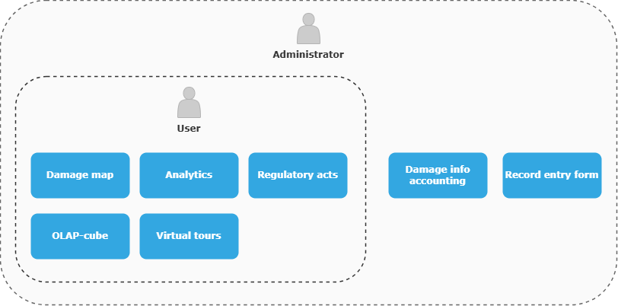
As part of this work, we have developed a prototype of the "Virtual Tours" module, which serves as an addition to the existing damage recording system. Overall, the purpose of the system is to document and analyze damaged infrastructure objects.
8

Slide 9
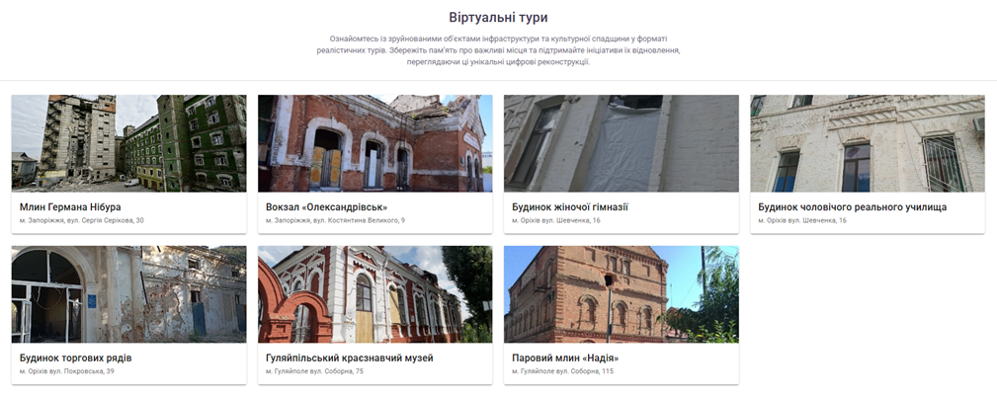
On the main page of the tours the damaged objects list is displayed. Users are able to select the tour that is most interesting to them and navigate to its page for more details.
9

Slide 10
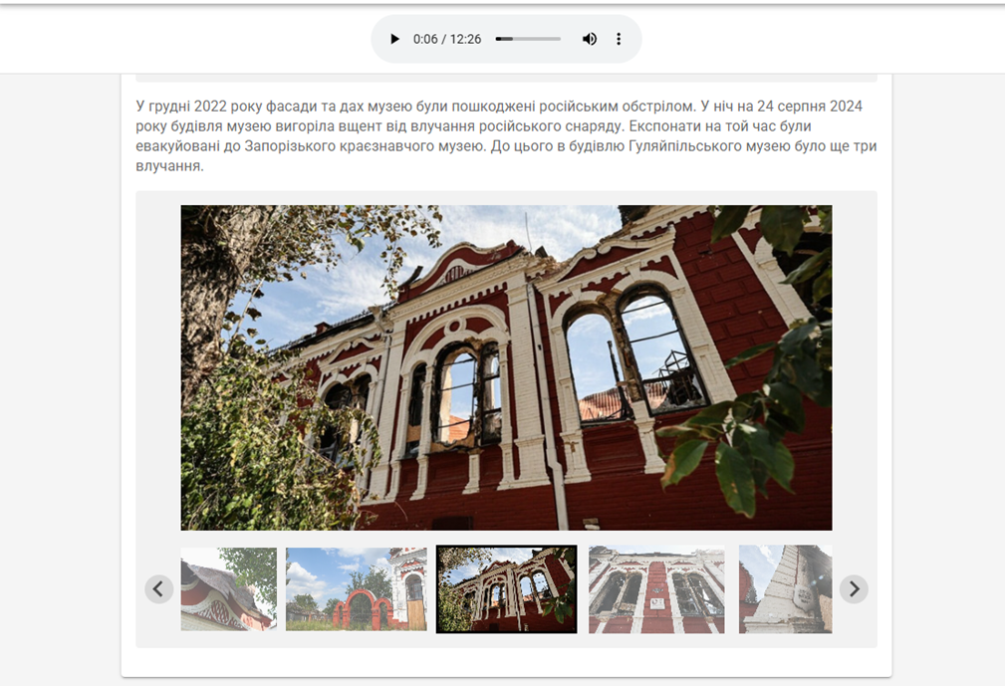
The tour page includes an overview of the object's condition before and after the damage.
The virtual tour itself is conducted as an online excursion. This means that the available visual content, is supplemented with audio narration, providing additional explanations and historical information about the object.
10

Slide 11
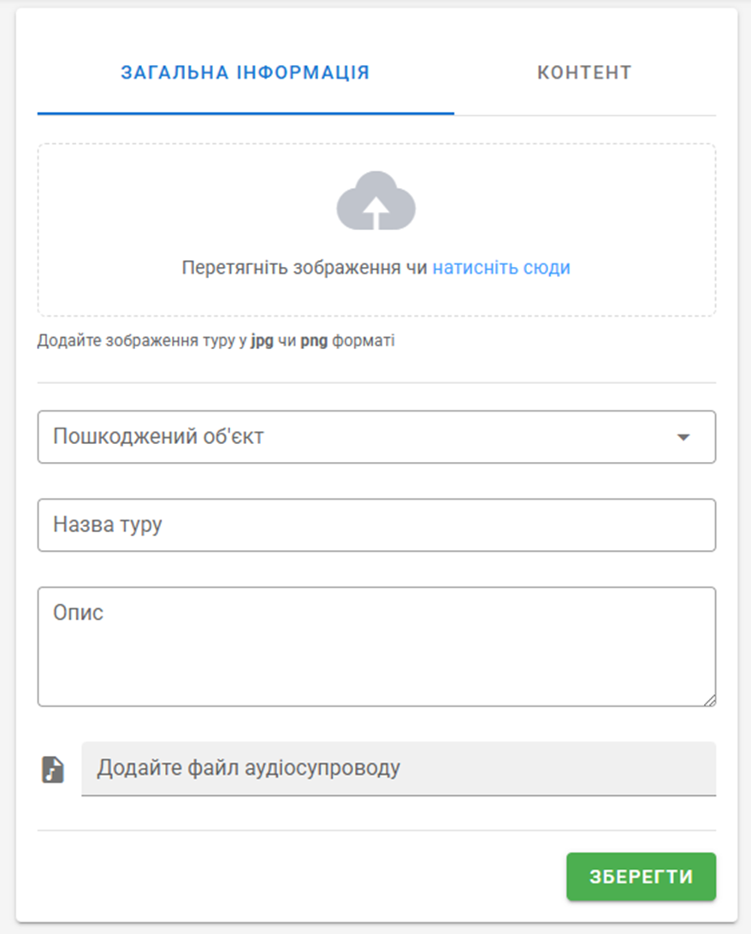
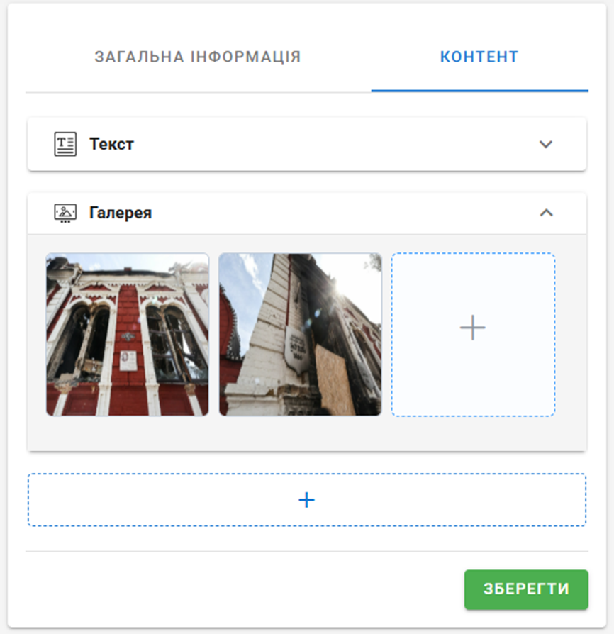
11

Slide 12
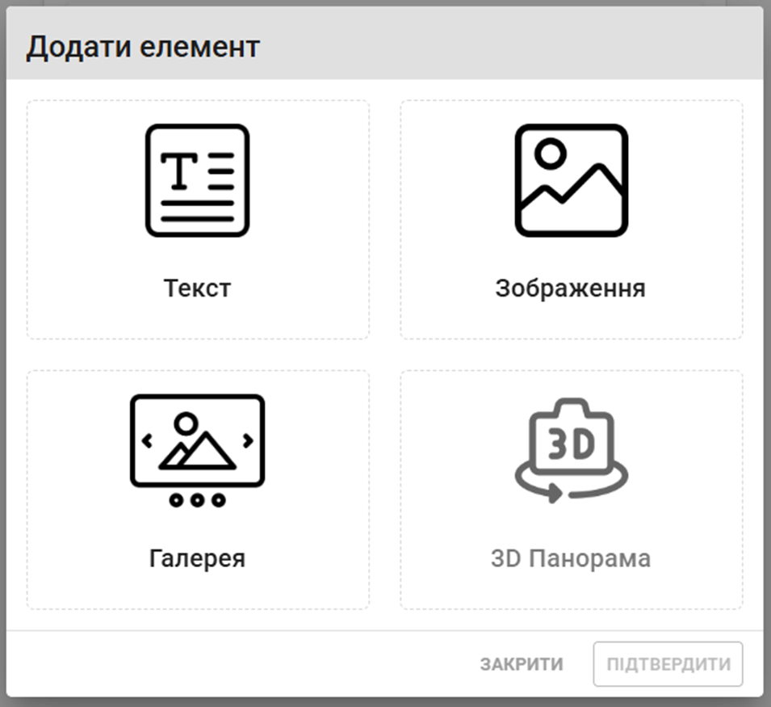
12

Slide 13
Conclusions
In general, the "Virtual Tours" module not only assists in the detailed recording of destruction, but also performs an important social function, allowing users to see the consequences of the war. This increases public awareness and helps attract funding for reconstruction by visualizing the actual condition of damaged objects.
The scientific novelty of this work lies in enhancing the existing information-analytical system through the development of the "Virtual Tours" module. It is assumed that the built system will be useful for the preparing of communities restoration strategies, attracting investors, as well as for the collection of future reparations.
13

Slide 14
Contacts
PO «Systemic directions of research»
https://sysresearch.zp.edu.ua
Department of system analysis and computational mathematics
+38 097 367 6675
+38 061 769 8247
14

